Slide 1
BME 495 Capstone 1
It’s all about the TEAM..!

Slide 2
As defined by Professor Leigh Thompson of the Kellogg School of Management, "[a] team is a group of people who are interdependent with respect to information, resources, knowledge and skills and who seek to combine their efforts to achieve a common goal".
A team is used only for a defined period of time and for a separate, concretely definable purpose. In that context, it can become known as a project team. In general, these types of teams are multi-talented and composed of individuals with expertise in many different areas. Project teams are temporary structures that can be characterized by a well-defined purpose or goal with time horizons and limits for reaching their goal.
Thompson, Leigh (2008). Making the team : a guide for managers (3rd ed.). Pearson/Prentice Hall. ISBN 9780131861350.
https://en.wikipedia.org/wiki/Team#cite_note-1

Slide 3
Self-Directing, High Performance Teams
A self-directed team determines the team's objectives and the means to achieve them. The team directs itself without the intervention of a manager or supervisor. Member selection, scheduling, task assignments and conflict resolution are undertaken by the team. Self-directed teams offer the most potential for innovation, enhance goal commitment and motivation.
A high performance team is a tight-knit group of talented individuals with specific roles, well-defined skills, and specialized expertise who synergistically function to collaborate, innovate, and deliver consistently superior results. Many elements of high-performing teams contribute to their success. For example, committing to a common goal or purpose, pursuing performance excellence through cross-department collaboration, open communication, and accountability.

Slide 4
High Performance Teams**
A "high-performance work team" refers to a group of goal-focused individuals with specialized expertise and complementary skills who collaborate, innovate and produce consistently superior results.
The group relentlessly pursues performance excellence through shared goals, shared leadership, collaboration, open communication, clear role expectations and group operating rules, early conflict resolution, and a strong sense of accountability and trust among its members.
**
https://www.shrm.org/resourcesandtools/tools-and-samples/toolkits/pages/developingandsustaininghigh-performanceworkteams.aspx

Slide 5
High Performance Teams**
Clear statement of purpose
Each member understands team's mission and vision
Shared goals, shared leadership
Clear role expectations
Strong sense of accountability
Early conflict resolution
**
https://www.shrm.org/resourcesandtools/tools-and-samples/toolkits/pages/developingandsustaininghigh-performanceworkteams.aspx

Slide 6
It is very important to understand that there is a distinction between a group and a team. You can have a group of friends, but that is not a team, and you may have to decide whether any of your friends can be an effective member of a team. That potential effectiveness cannot be assessed until there is an understanding of the project around which the team has to be formed.

Slide 7
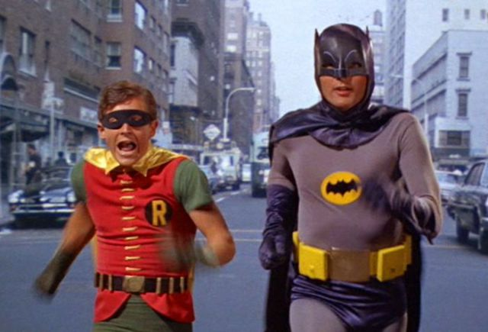
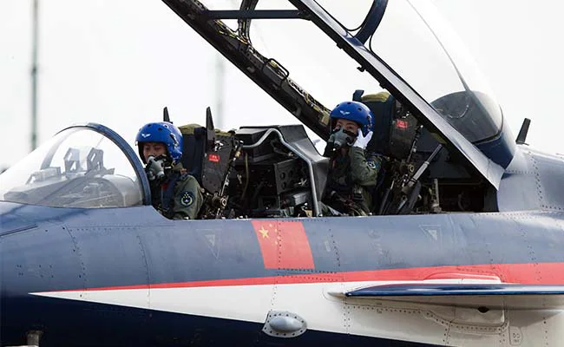
The Nature of a Team
The minimum number of possible team members is two…
https://izismile.com/2013/07/01/the_greatest_twoman_teams_the_world_has_ever_38_pics-4.htm
https://www.ndtv.com/world-news/chinas-first-female-aerobatic-fighter-pilots-take-flight-691872
https://metro.co.uk/2018/07/26/when-biryani-meets-joloff-interracial-couple-get-a-lot-of-love-online-7761979/

Slide 8
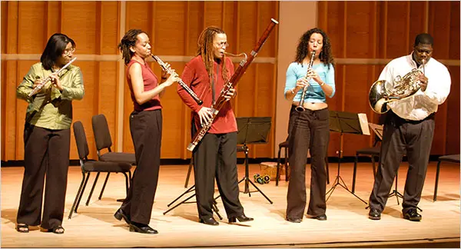
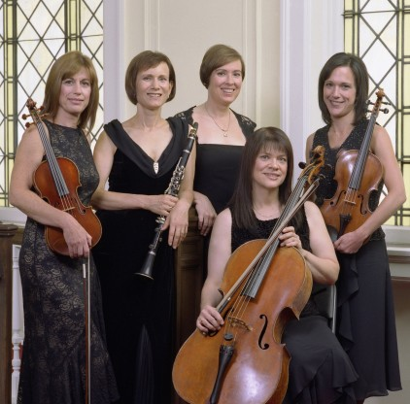
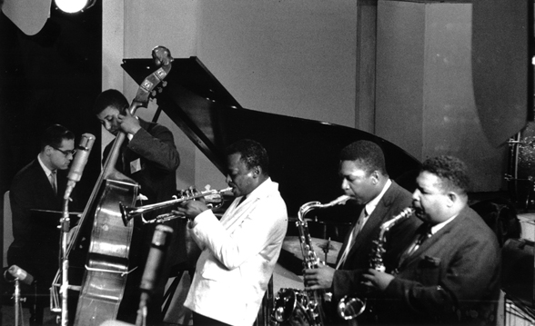
https://www.nytimes.com/2008/11/16/arts/music/16schw.html
A five-member team should function like a quintet of musicians. Each one is playing something different, but they are all playing the same thing..!
https://chicagoclassicalreview.com/2010/11/orion-ensemble-digs-up-another-gem-with-dubois-quintet/
https://www.wtju.net/jazz-100-hour-52-miles-davis-first-great-quintet-sextet/

Slide 9
Team Size Depends on the Nature of the Project…
https://www.gq.com/story/nasa-spacemen-of-the-year-2012

Slide 10
In Capstone I, the target team size will be four (4). In some special cases, as decided by the instructors, the size can be increased to five (5).

Slide 11
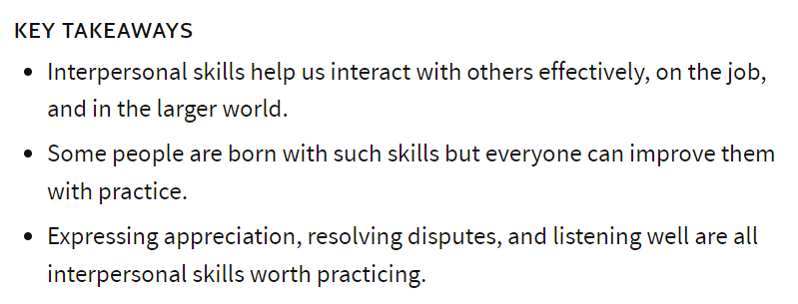
Your ability to work effectively in the Team context will be determined by your interpersonal skills…
Interpersonal skills are the behaviors and tactics a person uses to interact with others effectively. In the business world, the term refers to an employee's ability to work well with others. Interpersonal skills range from communication and listening to attitude and deportment.
Interpersonal Skills
https://www.investopedia.com/terms/i/interpersonal-skills.asp#:~:text=Interpersonal%20skills%20are%20the%20behaviors,listening%20to%20attitude%20and%20deportment.

Slide 12
The Origins of Team Conflict
Poorly formed goals. Each member of the team must endeavor to understand the goals of the Team and how their individual goal interface with the Team goals
Poor communication. The team should meet regularly and openly discuss all activity
Stress. There will be a period when you will experience the “fear of failure”. There is no one to blame for that. It is a natural consequence of addressing new and unfamiliar problems. However, it is during that period that you can manifest your highest level of innate creativity.

Slide 13
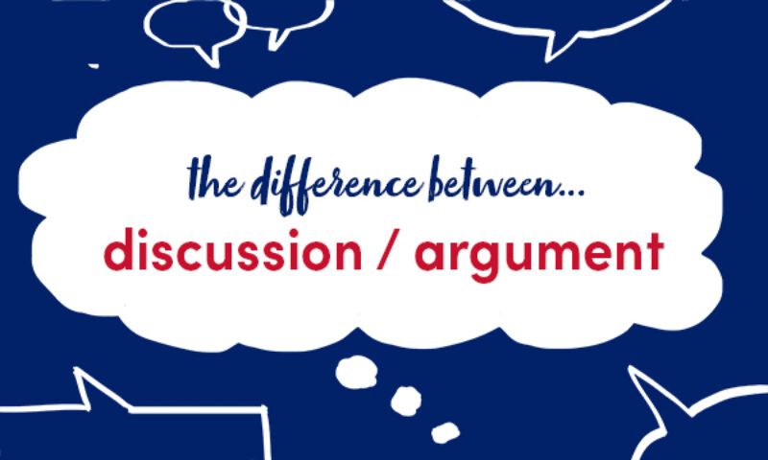
Differences in perspectives and approaches are natural and cannot be avoided…
https://blog.collinsdictionary.com/language-learners/learning-english/whats-the-difference-between-discussion-and-argument/

Slide 14
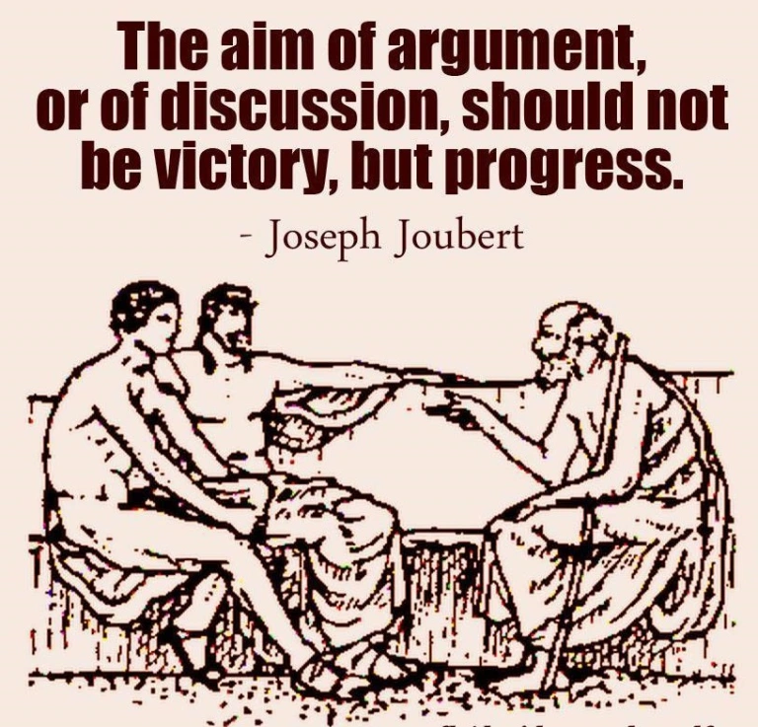
You always have the existential freedom to disagree with any concept that is presented to you. You have the responsibility to critically examine your disagreement, because embodied in your disagreement may be the kernel of new understanding…
https://www.britannica.com/biography/Joseph-Joubert

Slide 15
The floor is open:
Are there any questions or other points of discussion..?

